Slide 1
Software Engineering Lab 2021-22 Group:4 Topic : Bookshop Automation System
Md Tanwir Ahmad 19JE0514
Md Tauqeer Alam 19JE0515
Mihir Digamber Jichkar 19JE0526
Mohammed Sufiyanuddin 19JE0531

Slide 2
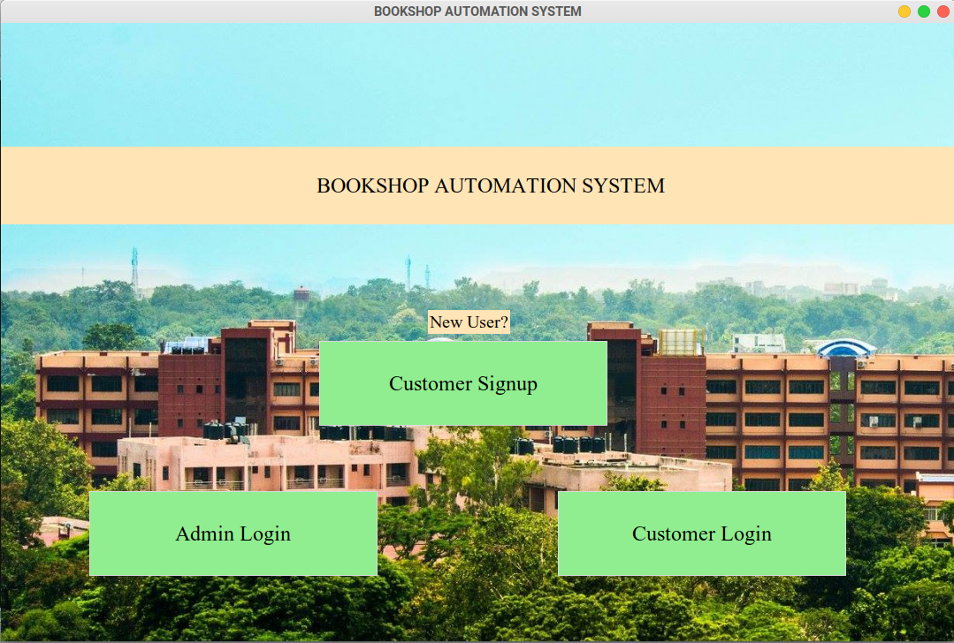

Slide 3
Actors:
Customer
Sales Clerk
Manager
Owner

Slide 4
Actors:
Customer
Sales Clerk
Manager
Owner

Slide 5
Customer
Actions
Customer can create an account and log in to record their activity
Customer can search for books using filters like book title, author, and genre
Customer can request books that the shop does not already have
Customer can view the status of a book: rack number, and availability
Customer can also view the previous orders they have placed

Slide 6
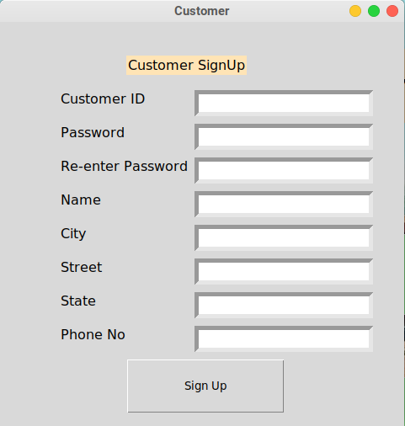
Customer Signup

Slide 7
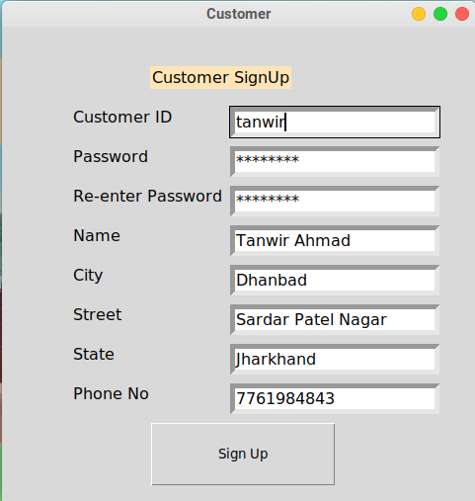
Customer Signup

Slide 8
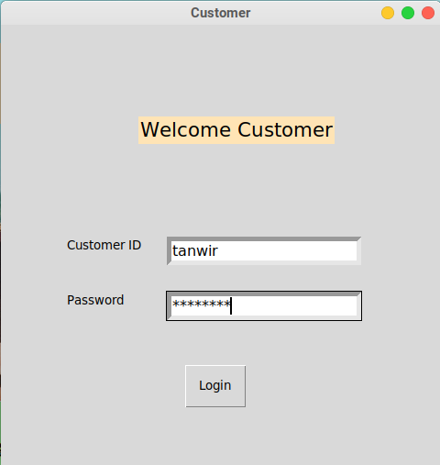
Customer Login

Slide 9
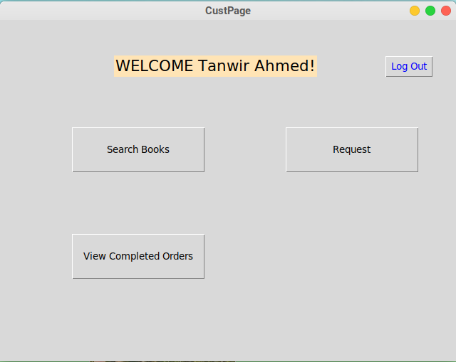
Customer dashboard

Slide 10
Customer dashboard

Slide 11
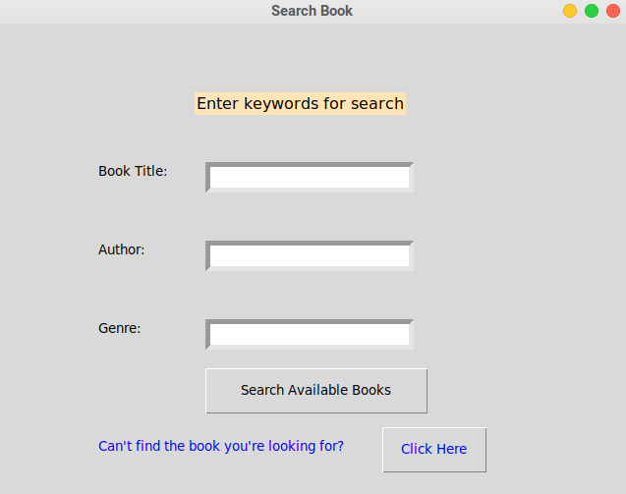
Search by book name, author name or genre
Request book if it does not exist

Slide 12
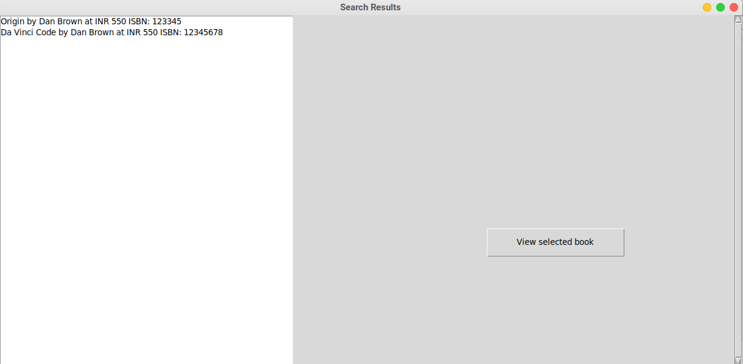
Search Result

Slide 13
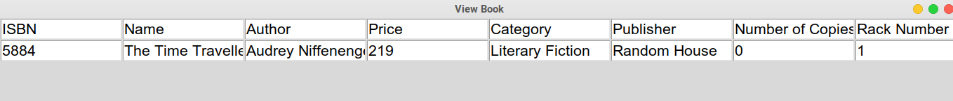
View Book

Slide 14
Customer dashboard

Slide 15
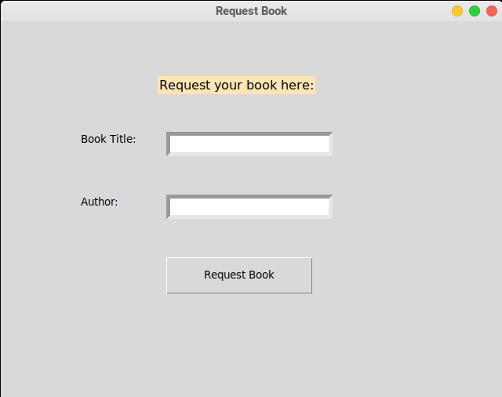
Request Book

Slide 16
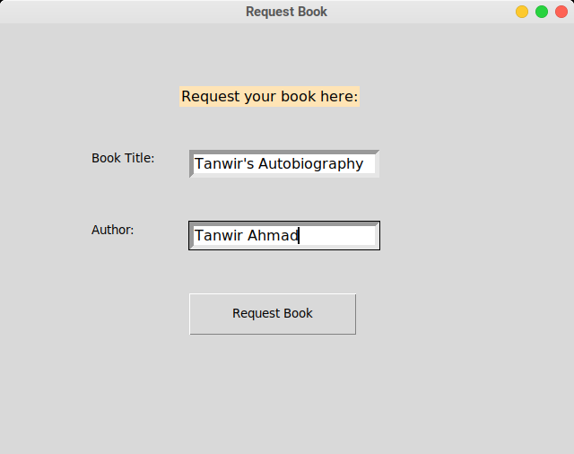
Request Book

Slide 17
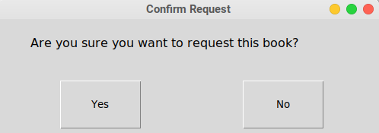
Request Book

Slide 18
Customer dashboard

Slide 19
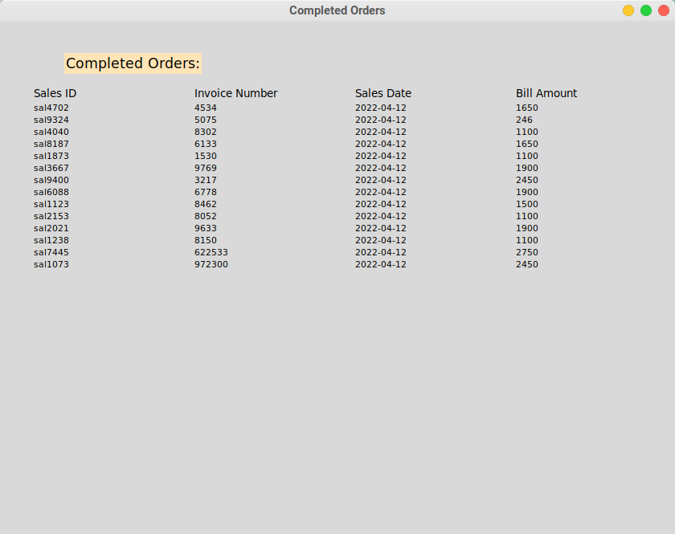
Completed Orders

Slide 20
Actors:
Customer
Sales Clerk
Manager
Owner

Slide 21
Sales Clerk
Actions
Sales Clerk can add books to inventory
Sales Clerk can update the inventory.
Sales Clerk can search for books.
Sales Clerk can place order and generate the receipt
Sales clerk can update the database

Slide 22
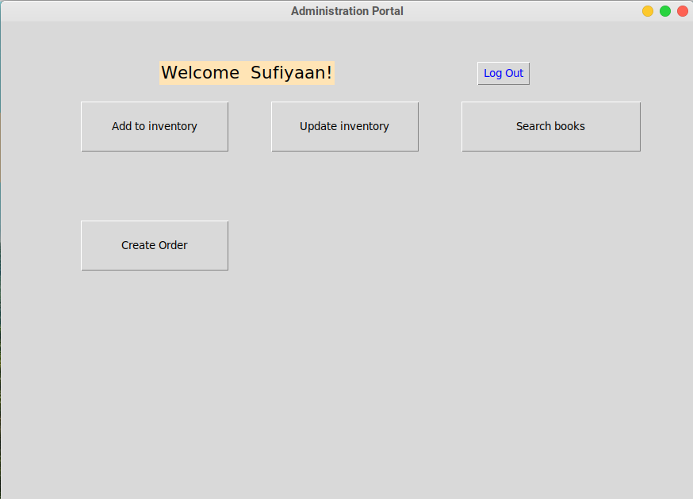
Sales Clerk Window

Slide 23
Sales Clerk Window

Slide 24
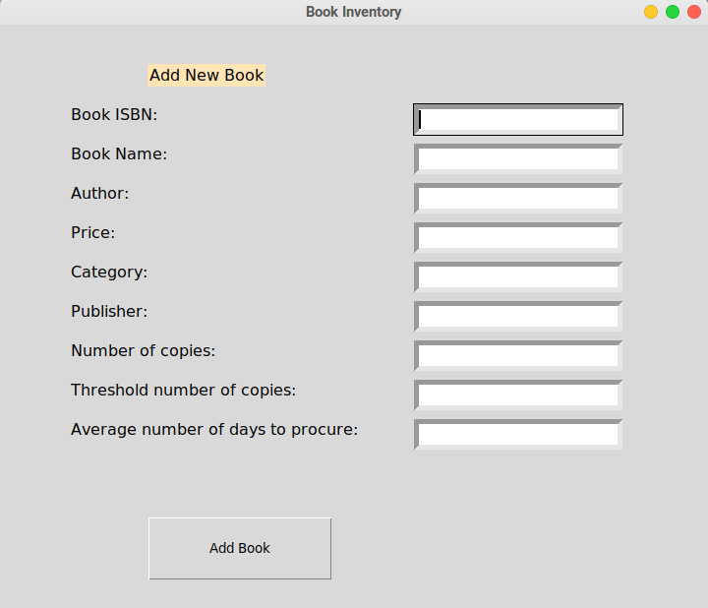
Add a new book

Slide 25
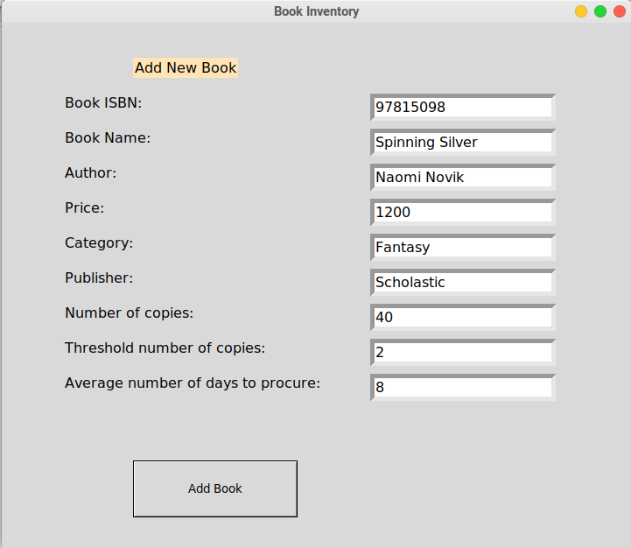
Add a new book

Slide 26
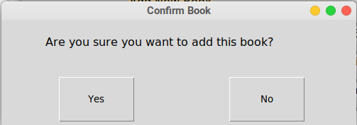
Add a new book Confirmation

Slide 27
Sales Clerk Window

Slide 28
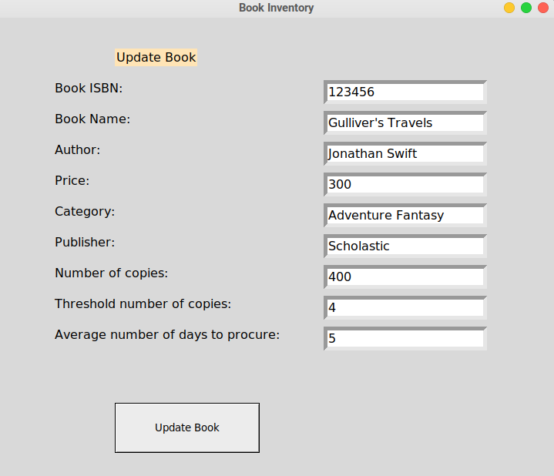
Update book

Slide 29
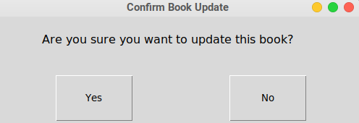
Update book confirmation

Slide 30
Sales Clerk Window

Slide 31
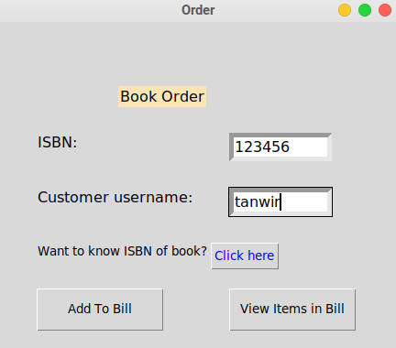
Order a book

Slide 32
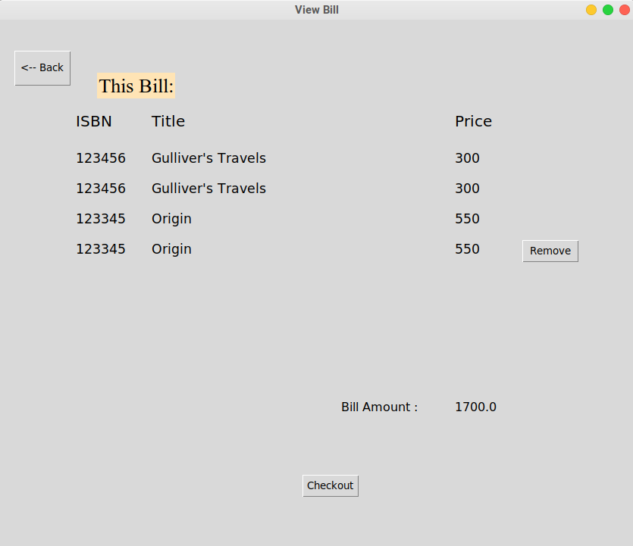
View Bill

Slide 33
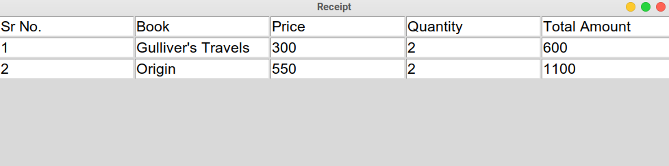
View Receipt

Slide 34
Actors:
Customer
Sales Clerk
Manager
Owner

Slide 35
Manager
Actions
Manager can do everything the sales clerk can.
Manager can check sales records.
Manager can check purchase records.
Manager can add purchases.
Manager can view requested books by customers.

Slide 36
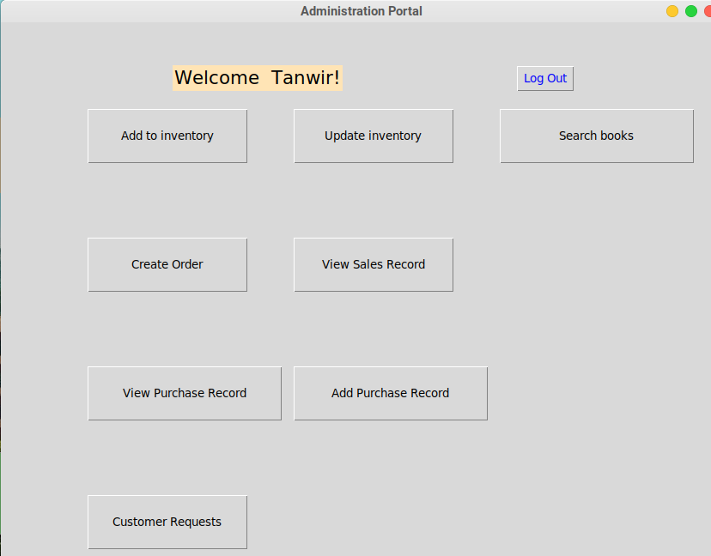
Manager Dashboard

Slide 37
Manager Dashboard

Slide 38
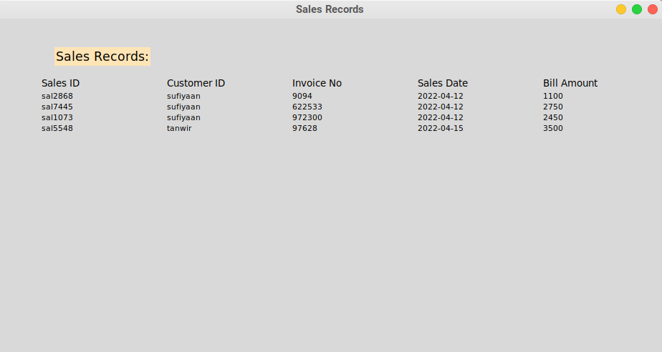
View Sales Records

Slide 39
Manager Dashboard

Slide 40
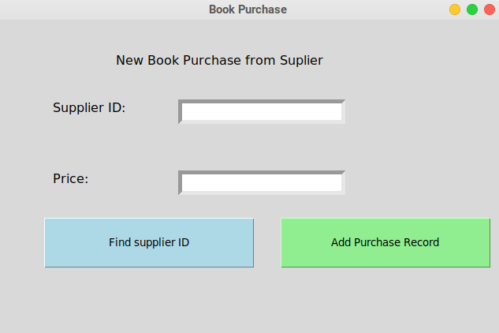
Add Purchase Record
If you don’t know the supplier ID

Slide 41
Add Purchase Record
Add record by clicking this button

Slide 42
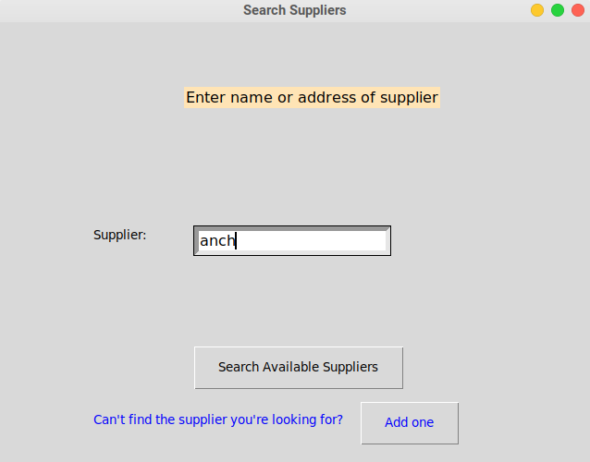
Add Purchase Record
Find supplier
Add a new supplier if one does not already exist

Slide 43
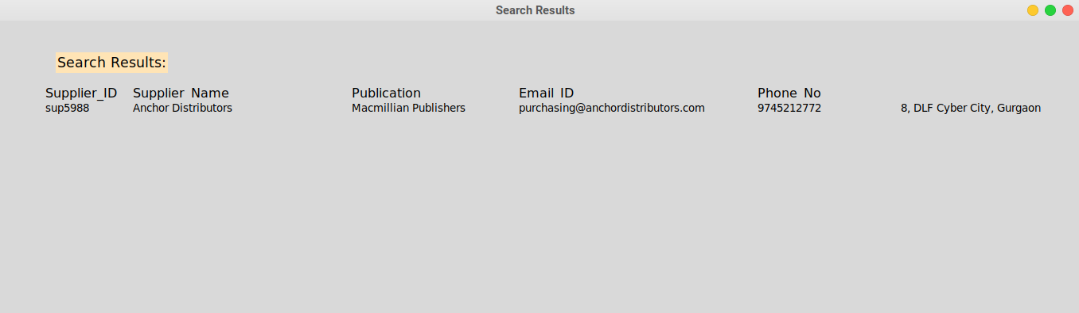
Add Purchase Record
Find supplier
Search results

Slide 44
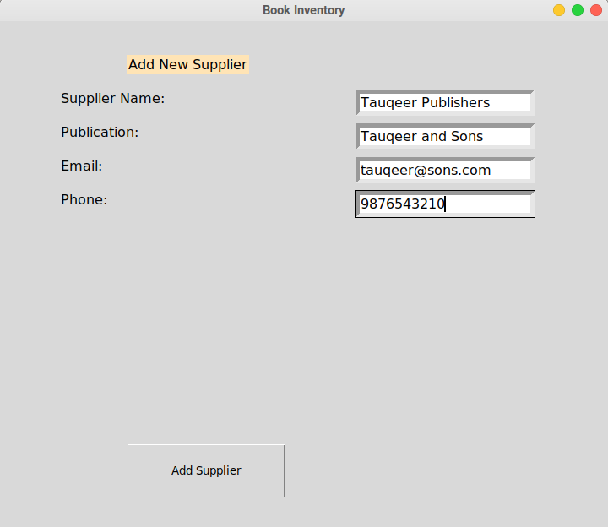
Add Purchase Record
Find supplier
Add supplier

Slide 45
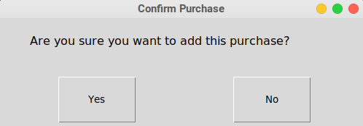
Add Purchase Record
Confirm

Slide 46
Manager Dashboard

Slide 47
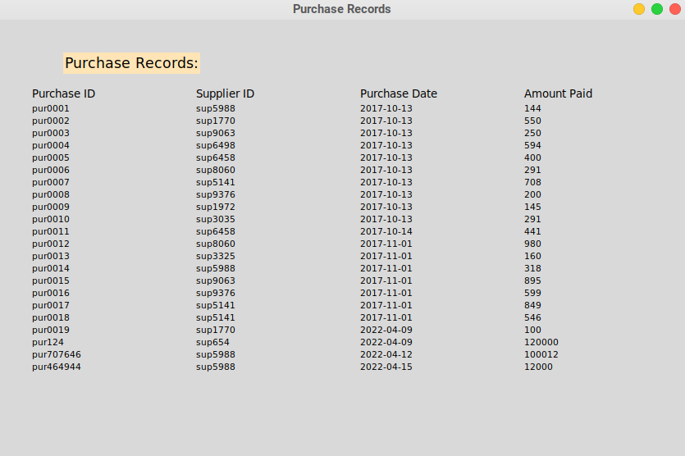
View Purchase Records

Slide 48
Manager Dashboard

Slide 49
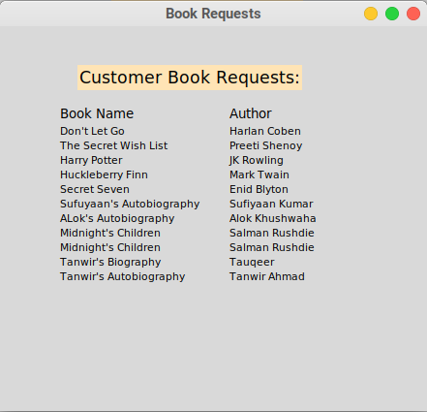
View Customer Requested Books

Slide 50
Actors:
Customer
Sales Clerk
Manager
Owner

Slide 51
Owner
Actions
Owner can check the sales statistics by selecting the starting date and ending date.
Owner can check the inventory levels by inputting the ISBN number.
Owner can check the books which are below threshold level by selecting the “Get List ” option.

Slide 52
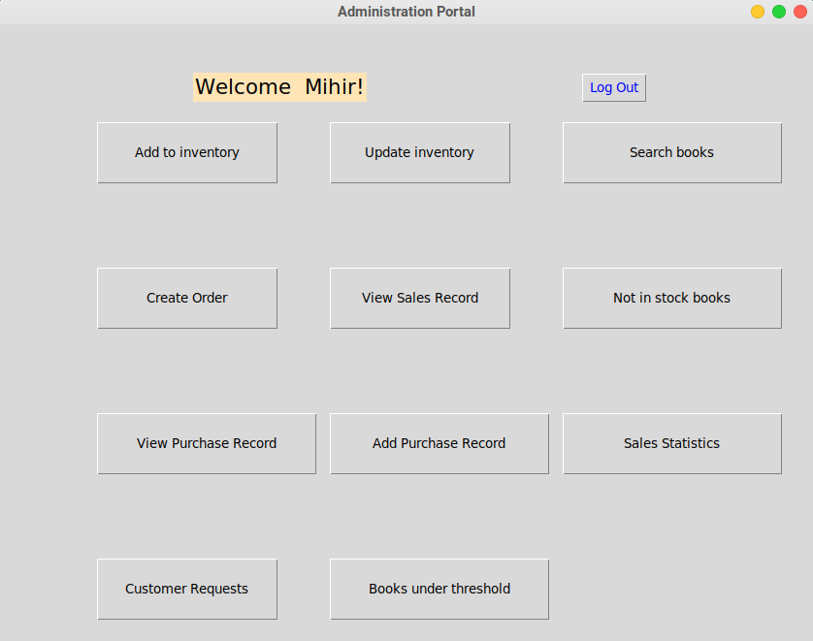
Owner Dashboard

Slide 53
Owner Dashboard

Slide 54
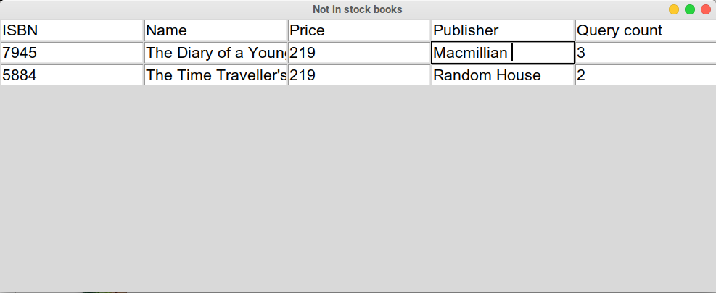
View Not-In-Stock Books

Slide 55
Owner Dashboard

Slide 56
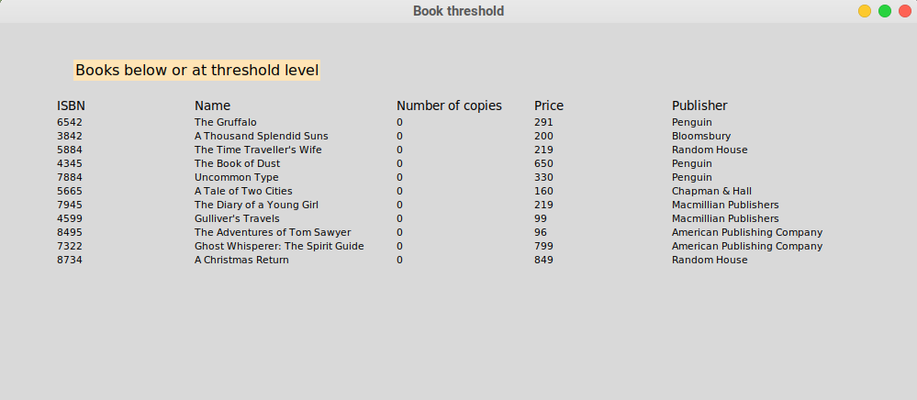
View Books under threshold level

Slide 57
Owner Dashboard

Slide 58
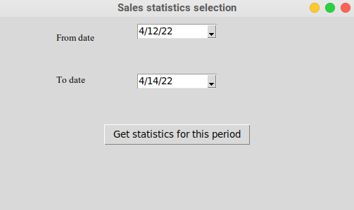
Sales Statistics
Select Date

Slide 59
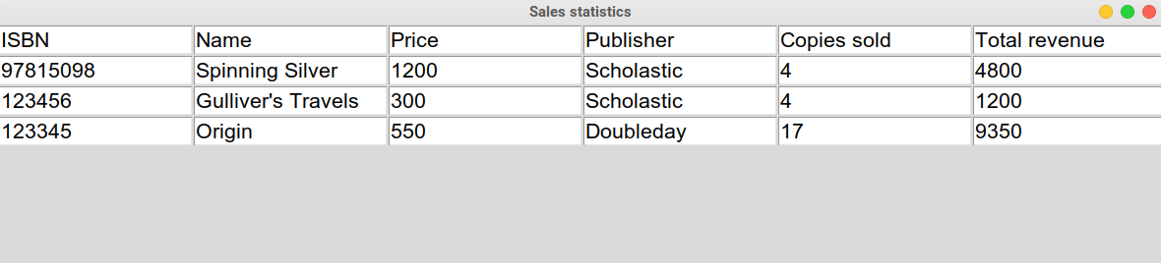
Sales Statistics
Select Date
Statistics results

Slide 60

THANKS!
Notes:
Thank you, no, we are not sales interns at SUBARU or anything like that.

